Slide 1


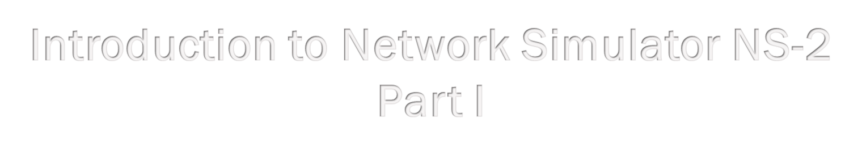



Slide 2
Outlines
Overview
Installation
An example
Incorporate C++ modules into NS2

Slide 3
Overview: A Study of Computer Networks
• Is your proposed solution great?
– Experiment:
Put all routers together and let people use them (realistic but expensive)
– Mathematic model:
probability theories, apply numerical methods (too many assumptions)
    Preferable for simple and small systems
– Simulation:
Use programming (e.g., C++, java, OPNET or NS2) to represent routers ( cheep and easy)

Slide 4
Overview: NS2 versus OPNET
 | OPNET | NS2
License | Needed | free
open source | No | Yes
documentation | A lot | Less
pre-implemented algorithms & protocols | Many | Less
Preferable | Network operators | Network researchers

Slide 5
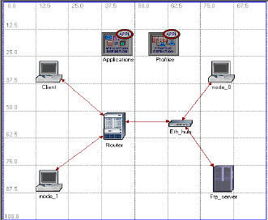
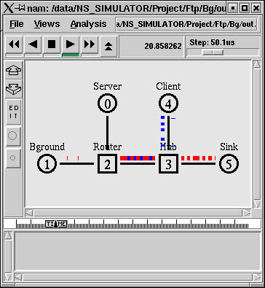
Network Representation in
OPNET and NS2
OPNET
NS2

Slide 6
Overview: Network Simulation
3 simulation main steps:
1. Design
• Algorithm
• Assumptions
• Performance measure
2. Simulation
• Network Configuration Phase
• Simulation Phase
3. Results
• Debugging and Tracing
• Compute performance measures

Slide 7
Overview: What is NS2
NS2 = Network Simulator 2
Event driven packet level network simulator
Version 1 of NS was developed in 1995 and with version 2 released in 1996.
It is an open source software package
Available for Windows and Linux platforms
Wired and wireless networks

Slide 8



Overview: NS2 Architecture
• Consists of
– C++: Internal mechanism
– OTcl: User interface
– TclCL: Connecting C++ to OTcl
TCL: Tool Command Language

Slide 9
Overview: NS2 Invocation
Syntax
>> ns [<filename>] [<args>]
- ns is the executable file of NS2
- <filename> = Tcl script file
    (net. Configurations and scenarios)
- In the Tcl file,
    <args> is stored in the internal variable ( $argv ).
Example
    ns myfirst_ns.tcl –dsr –seed 2

Slide 10
Outlines
• Overview
• Installation
• An Example
• Incorporate C++ Modules into NS2

Slide 11
Installation: NS2
1. Go to NS2 web page:
– NS2 Webpage: http://www.isi.edu/nsnam/ns/
– Download Link: http://www.isi.edu/nsnam/ns/ns-build.html#allinone1.
2. Get all-in-one package
– NS2, Tcl/Tk, OTcl, TclCL
– NAM, Zlib, Xgraph

Slide 12
Installation: NS2
3. Unzip all the files
4. Use the installation package “./install”
  Follow the instruction
  NS2 is designed for Unix
  For windows, also install Cygwin
Cygwin = Linux emulation for windows

Slide 13
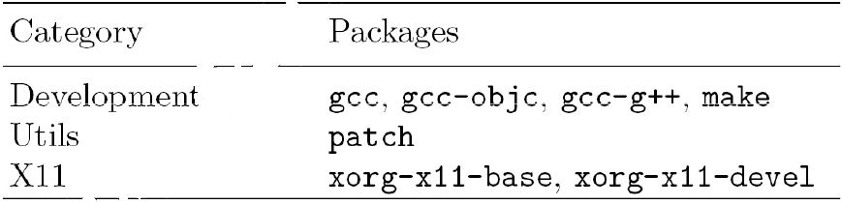
Installation: Cygwin
1. Go to Cygwin Webpage: http://www.cygwin.com/
2. Get the package
3. Install the basic package
4. Install the following additional packages:

Slide 14
Outlines
• Overview
• Installation
• An Example
• Incorporate C++ Modules into NS2

Slide 15
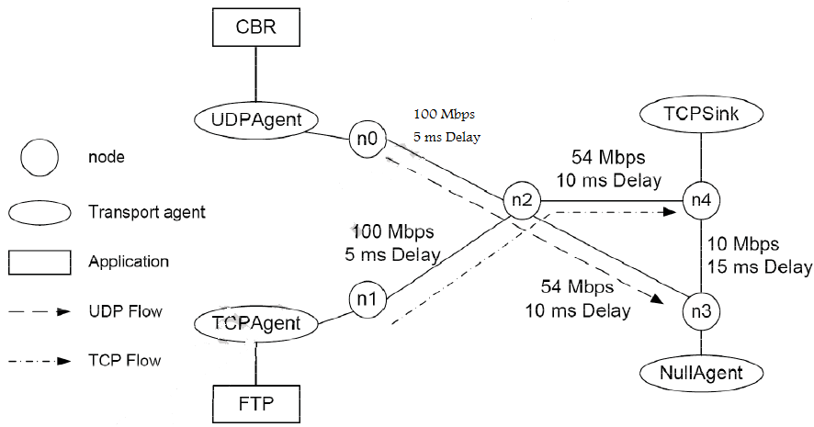
A Network Simulation Example

Slide 16
TCL Simulation Script
• Filename “myfirst_ns.tcl”
Create a simulator
  # Create a Simulator
  Set ns [new Simulator]
Create trace objects
  # Create a trace file
  set mytrace [open out.tr w]
  $ns trace-all $mytrace
  set myNAM [open out.nam w]
  $ns namtrace-all $myNAM

Slide 17
Example (cont…)
Define a “finish” procedure
  # Define a procedure finish
  proc finish { } {
    global ns mytrace myNAM
    $ns flush-trace
    close $mytrace
    close $myNAM
    exe nam out.nam &
    exit 0
  }

Slide 18
Example (cont…)
Create nodes
  # Create Nodes
  set n0 [$ns node]
  set n1 [$ns node]
  set n2 [$ns node]
  set n3 [$ns node]
  set n4 [$ns node]

Slide 19
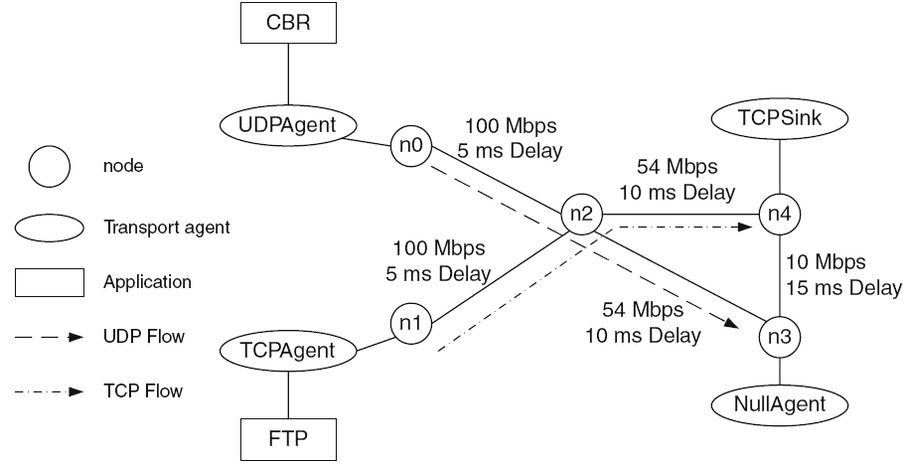
Example (cont…)

Slide 20
Example (cont…)
Connect nodes with “ duplex” links
  # Connect nodes with links
  $ns duplex-link $n0 $n2 100Mb 5ms DropTail
  $ns duplex-link $n1 $n2 100Mb 5ms DropTail
  $ns duplex-link $n2 $n4 54Mb 10ms DropTail
  $ns duplex-link $n2 $n3 54Mb 10ms DropTail
  $ns duplex-link $n3 $n4 10Mb 15ms DropTail
  $ns queue-limit $n2 $n3 40

Slide 21
Example (cont…)

Slide 22
Example (cont…)
Create a flow from n0 to n3
Create UDP flow
  set udp [new Agent /UDP]
  $ns attach-agent $n0 $udp
  set null [new Agent /Null]
  $ns attach-agent $n3 $null
  $ns connet $udp $null
  $udp set fid_ 1
Attach a CBR source to the UDP flow
  set cbr [new Application/Traffic/CBR]
  $cbr attach-agent $udp
  $cbr set packetSize_ 1000
  $cbr set rate_ 2Mb

Slide 23
Example (cont…)
Create a flow from n1 to n4
Create a TCP flow
  set tcp [new Agent/TCP]
  $ns attach-agent $n1 $tcp
  set sink [new Agent/TCPSink]
  $ns attach-agent $n4 $sink
  $ns connet $tcp $sink
  $tcp set fid_ 2
Attach an FTP source to the TCP flow
  Set ftp [new Application/FTP]
  $ftp attach-agent $tcp

Slide 24
Example (cont…)

Slide 25
Example (cont…)
Schedule Events
  $ns at 0.05 “$ftp start”
  $ns at 0.1 “$cbr start”
  $ns at 60.0 “$ftp stop”
  $ns at 60.5 “$cbr stop”
  $ns at 61 “finish”
Start Simulation
  $ns run

Slide 26
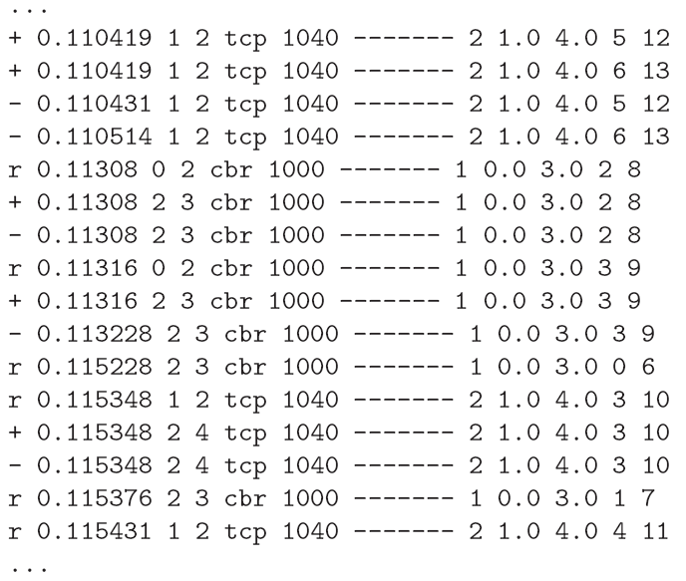
Trace File: Out.tr

Slide 27
Trace File: Out.tr
Identifier Type
  Four possible events for packets
    r (received)
    + (enqueued)
    - (dequeued)
    d (dropped)
In post-simulation analysis
  Extract the subset of interest data
  Analyze it
  Using AWK language: text files processing language

Slide 28
Outlines
• Overview
• Installation
• An Example
• Incorporate C++ Modules into NS2

Slide 29
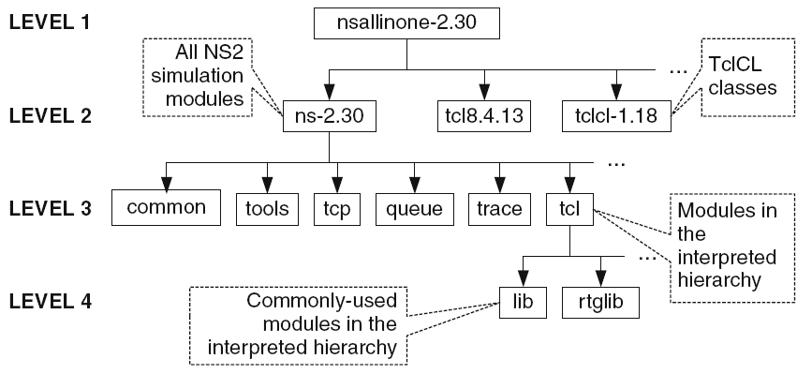
New Modules
Directory structure of NS2
Put the new modules on the same folder where you are working

Slide 30
New Modules
New Modules
– Need to recompile and links all NEW modules
– Use make utility
• “Make” contains a set of things that will be done when “make” is executed from the command prompt.

Slide 31
Make Utility
• Make usage
>> make [-f <filename>]
– Executed what specified in filename>
– <filename> is called a “file descriptor”
– No file is given use file “Makefile”
• File descriptor
– Syntax
<target1> [<target2> …] : [<dep1> <dep2> …]
<command>
– Targets are remade if any of the dependency is changed
– The change is specified in the command.

Slide 32
Makefile for NS2
• Located in ~ns
• Key components:
– INCLUDES = : Directory
– OBJ_CC = : All NS2 object files
– NS_TCL_LIB : All NS2 OTcl files
• Put your files in these three components

Slide 33
References
Textbook: T.Issariyakul and E. Hossain, Introduction to Network Simulator NS2, Springer 2008.
Slides in http://www.ece.ubc.ca/~teerawat/NS2.htm
http://www.cs.nuim.ie/research/reports/2004/nuim-cs-tr-2004-05.pdf
Gilberto, “OPNET Modeler and Ns-2: Comparing the Accuracy Of Network Simulators for Packet-Level Analysis using a Network Testbed”, http://privatewww.essex.ac.uk/~fleum/weas.pdf

